Slide 1

Filesystems
Maxim Sheverlatov
Jay Kothari
William M. Mongan
From Operating Systems Concepts by Bryant and O’Hallaron

Slide 2
Objectives
To explain the function of file systems
To describe the interfaces to file systems
To discuss file-system design tradeoffs, including access methods, file sharing, file locking, and directory structures
To explore file-system protection
To describe the details of implementing local file systems and directory structures
To describe the implementation of remote file systems
To discuss block allocation and free-block algorithms and trade-offs
Notes:
2

Slide 3
File Attributes
Like with Processes, what properties would we typically store with a file?
Where and how might we store them?
Notes:
3

Slide 4
File Attributes
Name – only information kept in human-readable form
Identifier – unique tag (number) identifies file within file system
Type – needed for systems that support different types
Location – pointer to file location on device
Size – current file size
Protection – controls who can do reading, writing, executing
Time, date, and user identification – data for protection, security, and usage monitoring
Information about files are kept in the directory structure, which is maintained on the disk
Notes:
4

Slide 5
File Operations
File is an abstract data type
Create
Write
Read
Reposition within file
Delete
Truncate
Open(F_{i}) – search the directory structure on disk for entry F_{i}, and move the content of entry to memory
  Multiple processes can have the same file open
Close (F_{i}) – move the content of entry F_{i} in memory to directory structure on disk
Notes:
5

Slide 6
Open Files
Several pieces of data are needed to manage open files:
  File pointer: pointer to last read/write location, per process that has the file open
  File-open count: counter of number of times a file is open – to allow removal of data from open-file table when last processes closes it
  Disk location of the file: cache of data access information
  Access rights: per-process access mode information
Notes:
6

Slide 7
Open File Locking
Provided by some operating systems and file systems
Mediates access to a file
Mandatory or advisory:
  Mandatory – access is denied depending on locks held and requested
  Advisory – processes can find status of locks and decide what to do
Notes:
7

Slide 8
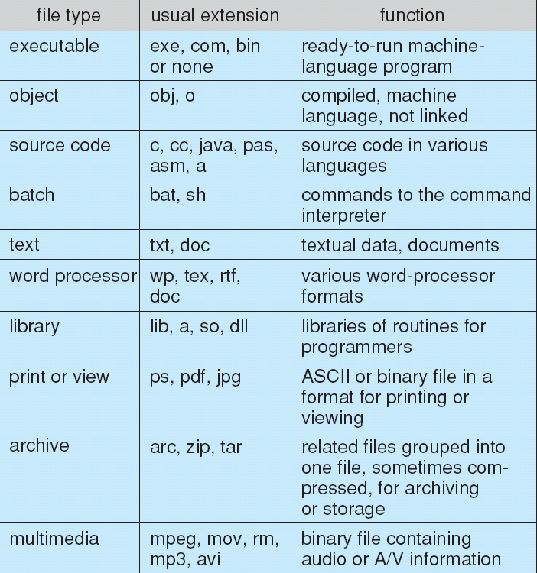
File Types – Name, Extension
Notes:
8

Slide 9
Access Methods
Sequential Access
read next
write next
reset
no read after last write
(rewrite)
Direct Access
read n
write n
position to n
read next
write next
rewrite n
n = relative block number
Notes:
9

Slide 10
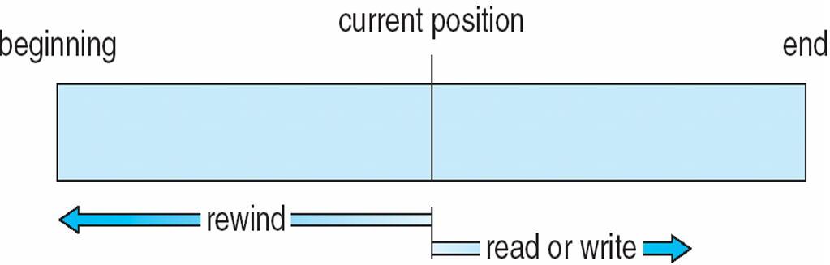
Sequential-access File
Notes:
10

Slide 11
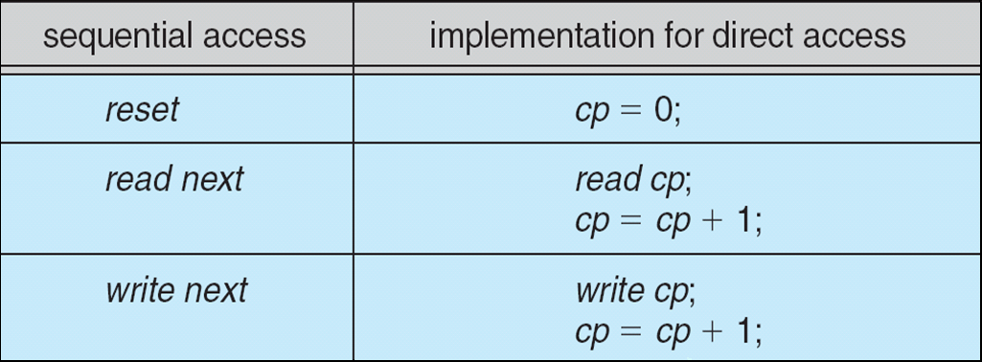
Simulation of Sequential Access on Direct-access File
Notes:
11

Slide 12
Disk Structure
Disk can be subdivided into partitions
Disks or partitions can be RAID protected against failure
Disk or partition can be used raw – without a file system, or formatted with a file system
Partitions also known as minidisks, slices
Entity containing file system known as a volume
Each volume containing file system also tracks that file system’s info in device directory or volume table of contents
As well as general-purpose file systems there are many special-purpose file systems, frequently all within the same operating system or computer

Slide 13
Directory Structure
A collection of nodes containing information about all files
Directory
Files
F 1
F 2
F 3
F 4
F n
Both the directory structure and the files reside on disk
Backups of these two structures are kept on tapes
Notes:
13

Slide 14
Filesystem Goals
Maximize sequential performance
Easy random access
Easy management of file (growth, truncation, etc.)

Slide 15
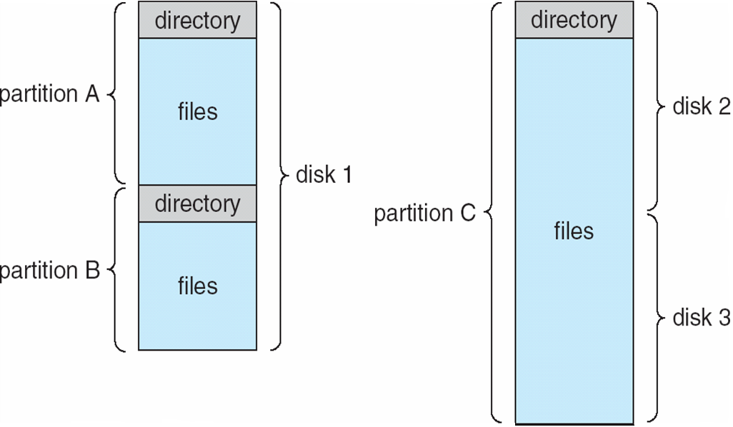
A Typical File-system Organization
Notes:
15

Slide 16
Accessing Files
All information about a file is contained in its header
  UNIX calls this the inode and are identified by global “inumbers”
  Once a header is loaded we can access all file blocks
How does one ask for a file?
  Specify an inode number
  Specify a textual name
If not an inode number then we need translation
  Translate from file name to inode number
  Distributed system translate from file name to server name and inode number

Slide 17
Directories
Directory: a relation used for naming and organization
  Just a table of (file name, inode) pairs
Often stored in files
  Reuse existing mechanism
  Directory named by inode, just like any other file
Needs to be quickly searchable
Originally to modify had to directly read/write a special file
Now syscalls for manipulation, mkdir, rmdir

Slide 18

Directory Organization
Entries in directory can be either files or directories
Files names by ordered sets (ex: /usr/bin/bash)
Organized as a hierarchical structure (really?)

Slide 19
Directory Structure
Not really a hierarchy
  Can be organized as an acyclic graph or a cyclic one
  Hard Links: different names for the same file
  Soft Links: “shortcut” pointers to other files
    Implemented by storing the actual file’s name
Name Resolution: Converting a logical name into a physical resource
  Traverse succession of directories until target file
  Global systems, must be spread across the network
one
two
three
a
b
c
d
e
f
g
c
d
c
d

Slide 20
Directory Structure
How many disk accesses to resolve “/usr/bin/bash”

Slide 21
Directory Structure
How many disk accesses to resolve “/usr/bin/bash”
  Read in header for root (fixed spot on disk)
  Read in first data block for root: search for “usr”
  Read in header for “usr”
  Read in first block for “usr”: search for “bin”
  Read in header for “bin”
  Read in first block for “bin”: search for “bash”
  Read in file header for “bash”
Current Working Directory: Pre-address-space pointer to a directory (inode) used for resolving file names
  Allows to specify relative filenames instead of absolute

Slide 22
Operations Performed on Directory
Search for a file
Create a file
Delete a file
List a directory
Rename a file
Traverse the file system
Notes:
22

Slide 23
Directory Implementation
Linear list of file names with pointer to the data blocks
  simple to program
  time-consuming to execute
Hash Table – linear list with hash data structure
  decreases directory search time
  collisions – situations where two file names hash to the same location
  fixed size
Notes:
23

Slide 24
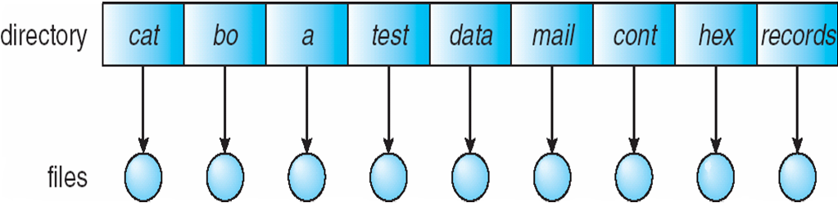
Single-Level Directory
A single directory for all users
Naming problem
Grouping problem
Notes:
24

Slide 25
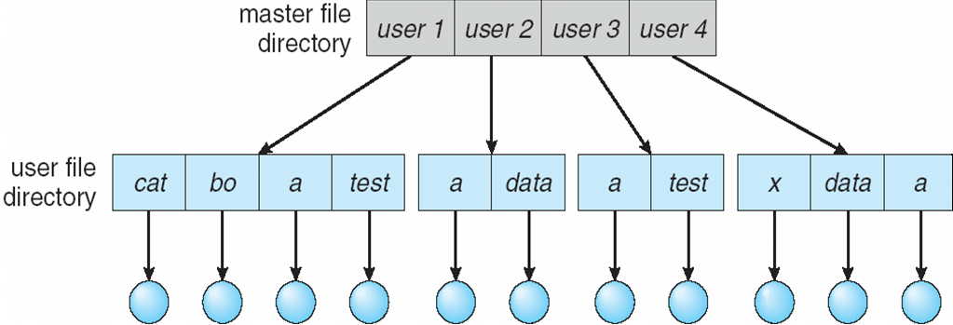
Two-Level Directory
Separate directory for each user
Path name
Can have the same file name for different user
Efficient searching
No grouping capability
Notes:
25

Slide 26
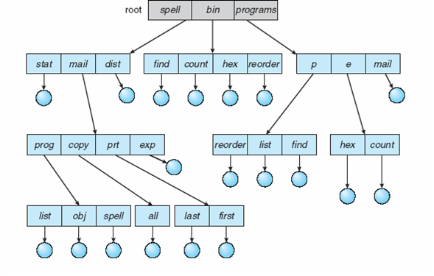
Tree-Structured Directories
Notes:
26

Slide 27
Tree-Structured Directories (Cont)
Efficient searching
Grouping Capability
Current directory (working directory)
  cd /spell/mail/prog
  type list
Notes:
27

Slide 28
Tree-Structured Directories (Cont)
Absolute or relative path name
Creating a new file is done in current directory
Delete a file
rm <file-name>
Creating a new subdirectory is done in current directory
  mkdir <dir-name>
Example: if in current directory /mail
mkdir count
mail
prog
copy
prt
exp
count
Deleting “mail” ⇒ deleting the entire subtree rooted by “mail”
Notes:
28

Slide 29
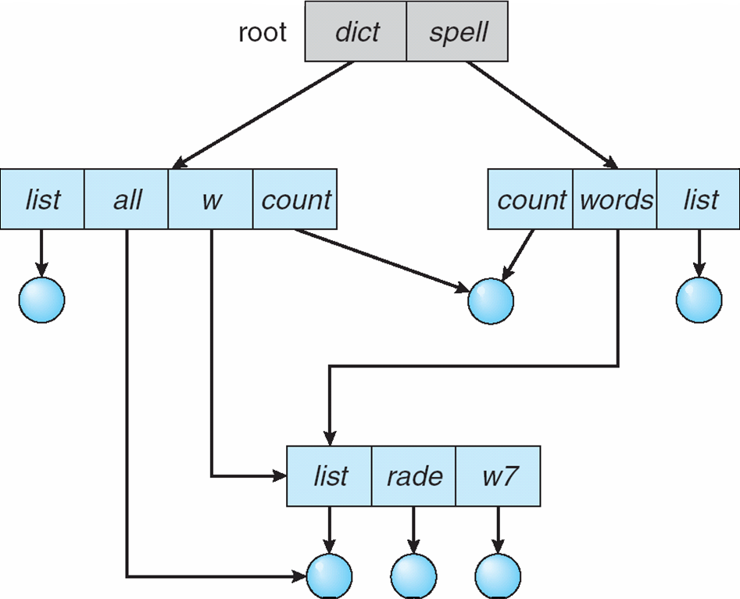
Acyclic-Graph Directories
Have shared subdirectories and files
Notes:
29

Slide 30
Acyclic-Graph Directories (Cont.)
Two different names (aliasing)
If dict deletes list ⇒ dangling pointer
Solutions:
  Backpointers, so we can delete all pointers
  Variable size records a problem
  Backpointers using a daisy chain organization
  Entry-hold-count solution
New directory entry type
  Link – another name (pointer) to an existing file
  Resolve the link – follow pointer to locate the file
Notes:
30

Slide 31
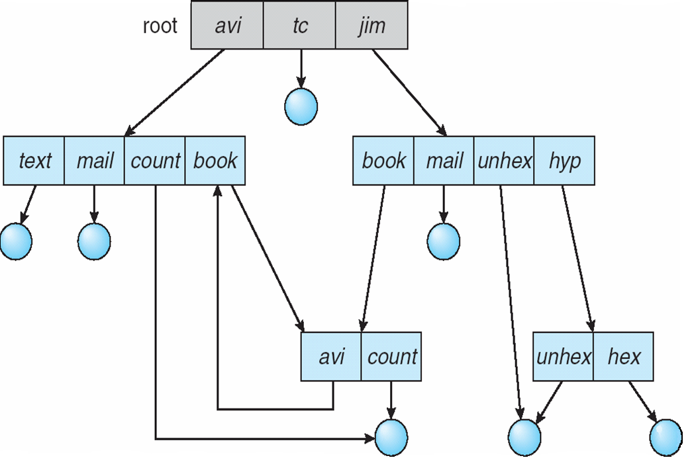
General Graph Directory
Notes:
31

Slide 32
General Graph Directory (Cont.)
How do we guarantee no cycles?
  Allow only links to file not subdirectories
  Garbage collection
  Every time a new link is added use a cycle detection
  algorithm to determine whether it is OK
Notes:
32

Slide 33
Where to store inodes?
In early UNIX and DOS/Windows FAT file systems headers stored in special array in outermost cylinders
  Not stored near data blocks
  To read first seek to get header, then seek to get file
Fixed size, set when formating the disk. Fixed number of inodes created, each with a unique inumber

Slide 34
Where are inodes stored now?
Moved header info to be closer to data blocks
Often, inode stored in the same cylinder group as parent directory of the file
  Makes “ls” run really fast
Headers are much smaller than data, so we can fetch multiple headers at the same time
Reliability: if the disk breaks, we can still find many files even if directory link was broken

Slide 35
Accessing Files
Open system call:
  Resolve file name and finds the associated control block
  Save state
  Return index in open-file table “file handle”
Read/Write system calls
  Use file handle to locate inode
  Perform operation

Slide 36
Protection
File owner/creator should be able to control:
  what can be done
  by whom
Types of access
  Read
  Write
  Execute
  Append
  Delete
  List
Notes:
36

Slide 37
Access Lists and Groups
Mode of access: read, write, execute
Three classes of users
RWX
a) owner access 7 ⇒ 1 1 1
RWX
b) group access 6 ⇒ 1 1 0
RWX
c) public access 1 ⇒ 0 0 1
Ask manager to create a group (unique name), say G, and add some users to the group.
For a particular file (say game) or subdirectory, define an appropriate access.
owner
group
public
chmod
761
game
Attach a group to a file
chgrp G game
Notes:
37

Slide 38
File-System Structure
File structure
  Logical storage unit
  Collection of related information
File system organized into layers
File system resides on secondary storage (disks)
  Provides efficient and convenient access to disk by allowing data to be stored, located retrieved easily
File control block – storage structure consisting of information about a file
Device driver controls the physical device
Notes:
38

Slide 39
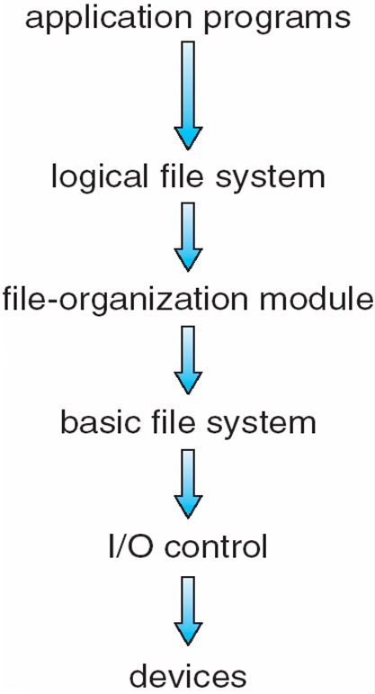
Layered File System
Notes:
39

Slide 40
File-System Implementation
Boot control block contains info needed by system to boot OS from that volume
Volume control block contains volume details
Directory structure organizes the files
Per-file File Control Block (FCB) contains many details about the file

Slide 41
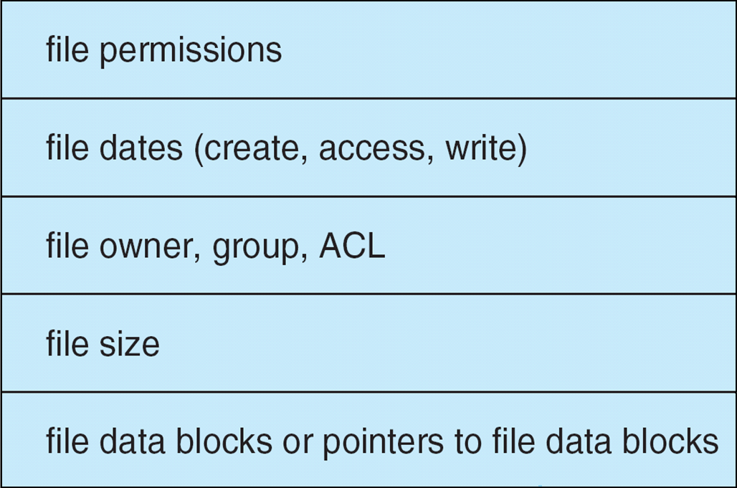
A Typical File Control Block
Notes:
41

Slide 42
Managing Multiple Systems
User Application
Virtual Filesystem (VFS) provides an abstraction and API to be used by several underlining file systems
  Hides implementation from users
  A filesystem may be local or distributed
GNU C Library
User Space
System Call Interface
Inode Cache
Virtual File System
Directory Cache
Individual File Systems
Kernel Space
Buffer Cache
Device Drivers

Slide 43
Virtual File Systems
Virtual File Systems (VFS) provide an object-oriented way of implementing file systems.
VFS allows the same system call interface (the API) to be used for different types of file systems.
The API is to the VFS interface, rather than any specific type of file system.
Notes:
43

Slide 44
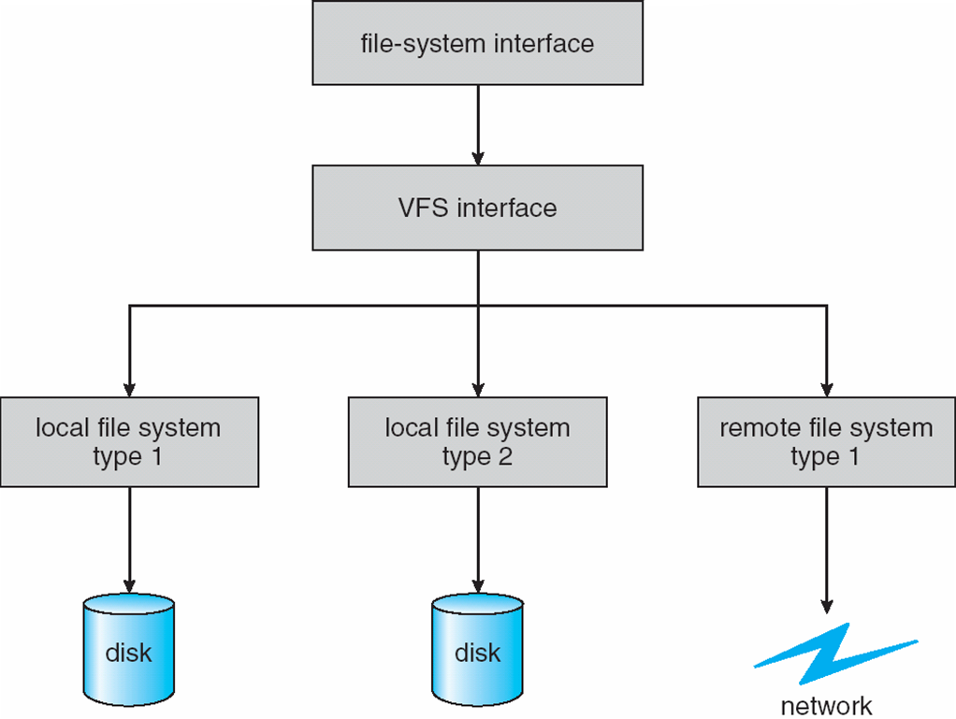
Schematic View of Virtual File System
Notes:
44

Slide 45
Directory Implementation
Linear list of file names with pointer to the data blocks.
  simple to program
  time-consuming to execute
Hash Table – linear list with hash data structure.
  decreases directory search time
  collisions – situations where two file names hash to the same location
  fixed size
Notes:
45

Slide 46
Allocation Methods
An allocation method refers to how disk blocks are allocated for files:
Contiguous allocation
Linked allocation
Indexed allocation
Notes:
46

Slide 47
Contiguous Allocation
Each file occupies a set of contiguous blocks on the disk
Simple – only starting location (block #) and length (number of blocks) are required
Random access
Wasteful of space (dynamic storage-allocation problem)
Files cannot grow
Notes:
47

Slide 48
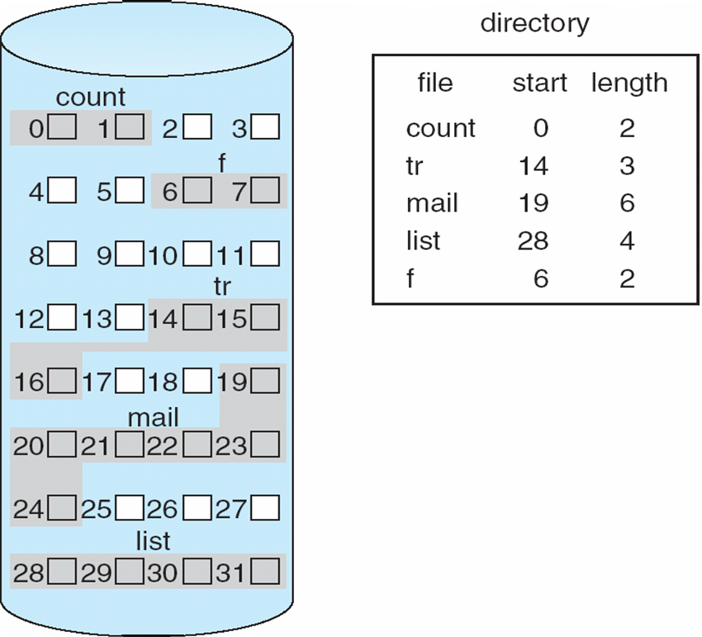
Contiguous Allocation of Disk Space
Notes:
48

Slide 49
Extent-Based Systems
Many newer file systems (I.e. Veritas File System) use a modified contiguous allocation scheme
Extent-based file systems allocate disk blocks in extents
An extent is a contiguous block of disks
  Extents are allocated for file allocation
  A file consists of one or more extents
Notes:
49

Slide 50
Linked Allocation
Each file is a linked list of disk blocks: blocks may be scattered anywhere on the disk.
block =
pointer
Notes:
50

Slide 51
Linked List Allocation
block
block
block
header
NULL
What’s Good/Bad here?

Slide 52
Linked List Allocation
block
block
block
header
NULL
Can easily grow files
Bad sequential access
Bad random access
Unreliable, one block lost the rest is lost with it

Slide 53
Linked Allocation:FAT
Link pages together to create a file
Links are not stored in pages, but in the File Allocation Table (FAT)
  Contains entry for each page
What’s Good/Bad here?
file
200
0
200
300
300
600
600

Slide 54
Linked Allocation:FAT
Link pages together to create a file
Links are not stored in pages, but in the File Allocation Table (FAT)
  Contains entry for each page
Bad sequential access
  better if FAT cached in memory
Bad random access
  better if FAT cached in memory
file
200
0
200
300
300
600
600

Slide 55
Indexed Allocation
Brings all pointers together into the index block
Logical view
index table
Notes:
55

Slide 56
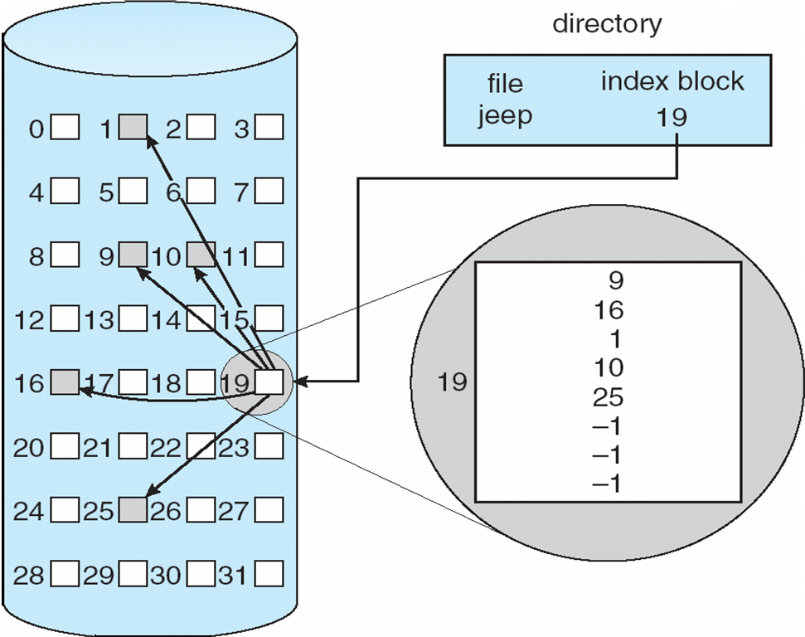
Example of Indexed Allocation
Notes:
56

Slide 57
Indexed Allocation
0
1
2
3
file 15
Header block to hold pointers to all blocks
  user pre-declares max file size
File can grow to max space
What’s Good/Bad here?
4
5
6
7
8
9
10
11
6
17
9
-1
-1
12
13
14
15
16
17
18
19
20
21
22
23

Slide 58
Indexed Allocation
0
1
2
3
file 15
Header block to hold pointers to all blocks
  user pre-declares max file size
File can grow to max space
Random access is easy
Bad sequential access
Hard to grow beyond table size
4
5
6
7
8
9
10
11
6
17
9
-1
-1
12
13
14
15
16
17
18
19
20
21
22
23

Slide 59
Multilevel Indexed Allocation
Efficient for small files, while allowing large files
Used in UNIX 4.1
Header (inode) contains 13 pointers
  first 10 => data
  11 => indirect block, 256 pointers
  12 => doubly indirect, 256 indirect blocks = 64K blocks
  13 => triply indirect = 16M blocks
What’s Good/Bad here?
header
data
data
......
direct blocks
data
......
data
......
single indirect
data
......
data
double indirect
......
data
triple indirect
Notes:
How large of a file can we support if each block is a certain size?

Slide 60
Discussion
Places a limit of about 16G per file
  Large enough?
  How large of a file/disk can we support (address) exactly? Why?
Pointers are filled dynamically
OK random access
Bad sequential access
Small files are cheap
Files can grow
Accessing large files very expensive, 4 reads per block
How many reads for block 200?
How many for 5?
How many for 400?
header
data
data
......
direct blocks
data
......
data
......
single indirect
data
......
data
double indirect
......
data
triple indirect

Slide 61
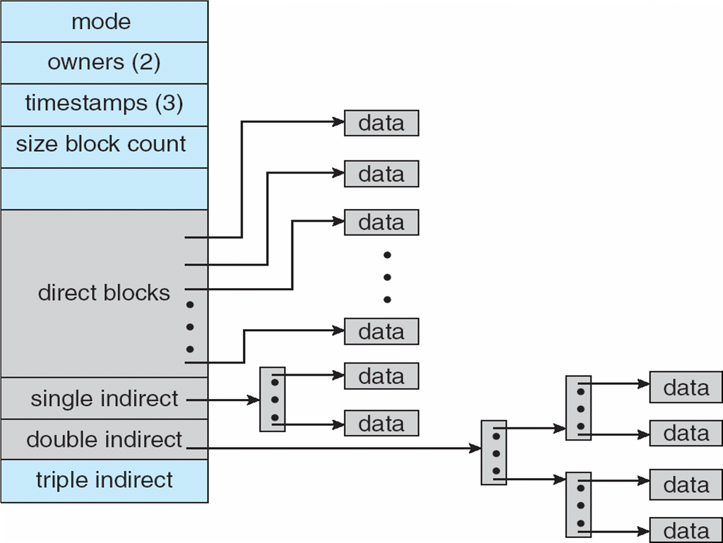
Combined Scheme: UNIX UFS (4K bytes per block)
Notes:
61

Slide 62
Free Blocks
How do we know which blocks are free?

Slide 63
Free Blocks
How do we know which blocks are free?
Bit-Map
  Mark blocks as free of used
  Can be fast if bit-map cached in memory
  Easy to find large blocks of free space when drive is empty
  Hard when drive is mostly full
  Easy to manage locality
Free List
  List of free blocks
  Easier to quickly find free space
  Difficult to manage locality
When to use Bit-Map vs. Free List?

Slide 64
Free-Space Management
Bit vector (n blocks)
0
1
2
n-1
…

0 ⇒ block[i] free
1 ⇒ block[i] occupied
bit[i] =
Block number calculation
(number of bits per word) *
(number of 0-value words) +
offset of first 1 bit
Notes:
64

Slide 65
Free-Space Management (Cont.)
Bit map requires extra space
  Example:
block size = 2¹² bytes
disk size = 2³⁰ bytes (1 gigabyte)
n = 2³⁰/2¹² = 2¹⁸ bits (or 32K bytes)
Easy to get contiguous files
Linked list (free list)
  Cannot get contiguous space easily
  No waste of space
Grouping
Counting
Lec 4
Operating Systems
65
Notes:
65

Slide 66
Free-Space Management (Cont.)
Need to protect:
  Pointer to free list
  Bit map
    Must be kept on disk
    Copy in memory and disk may differ
    Cannot allow for block[i] to have a situation where bit[i] = 1 in memory and bit[i] = 0 on disk
  Solution:
    Set bit[i] = 1 in disk
    Allocate block[i]
    Set bit[i] = 1 in memory
Notes:
66

Slide 67
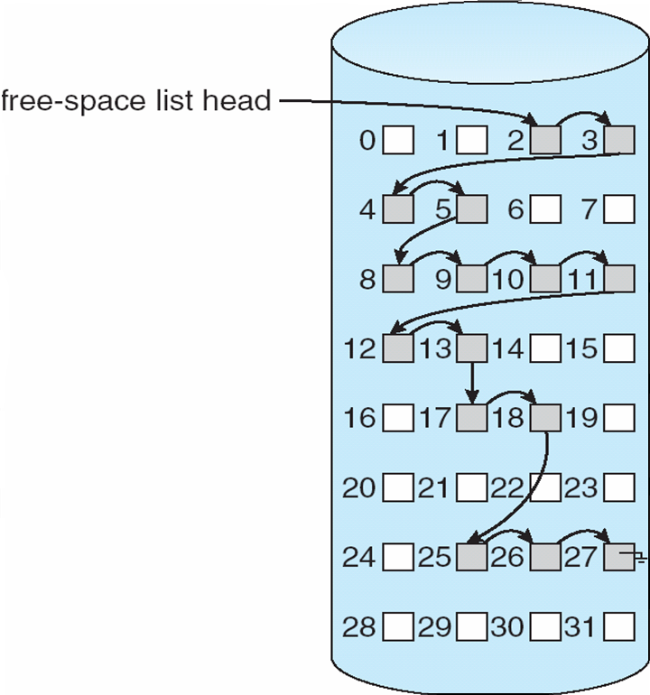
Linked Free Space List on Disk
Notes:
67

Slide 68
Efficiency and Performance
Efficiency dependent on:
  disk allocation and directory algorithms
  types of data kept in file’s directory entry
Performance
  disk cache – separate section of main memory for frequently used blocks
  free-behind and read-ahead – techniques to optimize sequential access
  improve PC performance by dedicating section of memory as virtual disk, or RAM disk
Notes:
68

Slide 69
File system caching
Exploit locality by caching data in memory
  Name translation (files in the same directory)
  Disk blocks
Replacement policy: LRU
  Overhead of time-stamps
  Works well for name translations
  Works ok as long as memory big enough to hold everything
  Problems when some app scans through the file system, flushing the cache
Better Replacement?
What about cache size?

Slide 70
More on caching
Cache size:
  Too much and applications won’t run well
  Too little and applications may run slowly (caching overhead)
  Adjust dynamically so that access rates for paging and file access are balanced
Prefetching
  Since most data is read in sequentially, prefetch blocks
  Elevator algorithm can efficiently interleave application

Slide 71
Yet more caching
Don’t immediately write to disk
  Store writes in cache
  Flush periodically
  Allows the kernel to better optimize writes
Problems???

Slide 72
Page Cache
A page cache caches pages rather than disk blocks using virtual memory techniques
Memory-mapped I/O uses a page cache
Routine I/O through the file system uses the buffer (disk) cache
This leads to the following figure
Notes:
72

Slide 73
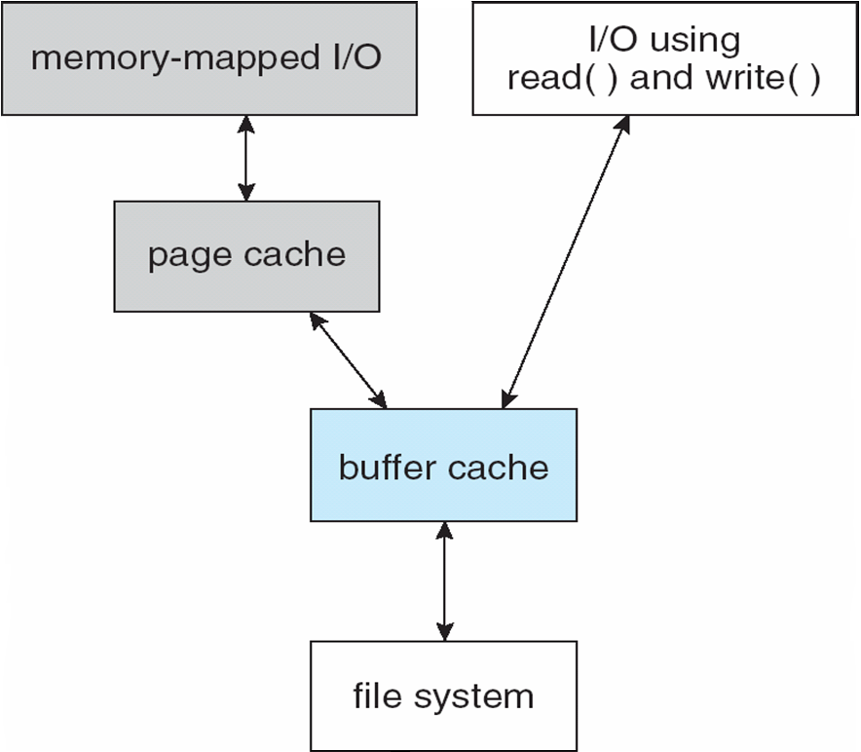
I/O Without a Unified Buffer Cache
Notes:
73

Slide 74
Unified Buffer Cache
A unified buffer cache uses the same page cache to cache both memory-mapped pages and ordinary file system I/O
Notes:
74

Slide 75
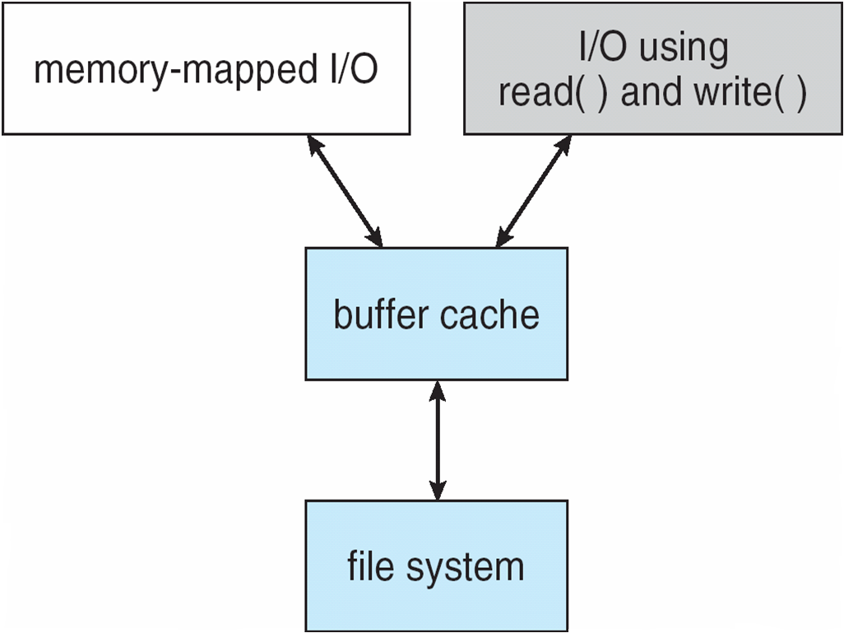
I/O Using a Unified Buffer Cache
Notes:
75

Slide 76
Recovery
Consistency checking – compares data in directory structure with data blocks on disk, and tries to fix inconsistencies
Use system programs to back up data from disk to another storage device (magnetic tape, other magnetic disk, optical)
Recover lost file or disk by restoring data from backup
Notes:
76

Slide 77
Log Structured File Systems
Log structured (or journaling) file systems record each update to the file system as a transaction
All transactions are written to a log
  A transaction is considered committed once it is written to the log
  However, the file system may not yet be updated
The transactions in the log are asynchronously written to the file system
  When the file system is modified, the transaction is removed from the log
If the file system crashes, all remaining transactions in the log must still be performed
Notes:
77

Slide 78
DEMOS Allocation
data
Filesystem used for Cray-1
Reduce seek by allocating continuous blocks
Fast sequential reads
Easy random access
Use bit-map to find empty space
10 block group pointers
If need more set “big file” flag in header and each block pointer points to indirect block of pointers
Problems when disk is full
  fragmentation
  hard to find continuous space
header
data
base
size
......
data

Slide 79
Managing DEMOS
In many systems disks are always full
Don’t let them
Reserve a portion
  if free space count < reserve don’t allocate
In practice 10% of disk seems good enough
Tradeoff: pay more for disk, but get contiguous allocation
  Since seeks are expensive, and disk is cheap, good tradeoff

Slide 80
UNIX BSD 4.2
Same as the previous inode set up, except use ideas from DEMOS
  Use bitmap allocation instead of freelist
  Attempt to allocate files contiguously
  10% reserved disk space
  Skip-sector positioning
When creating a file we don’t know how big it will become, how much contiguous space to allocate?
  In DEMOS grow space by power of 2: 1M, 2M, 4M
  In BSD 4.2 find some range of free blocks
    Put each file in front of a different range
    When expanding first try to expand the block, then find new range
    Also store files from the same directory next to each other

Slide 81
Summary
Continuous Allocation
  Good access, bad fragmentation
FAT
  Simple, less fragmentation, bad access
Indexed Allocation
  File size limit, less fragmentation, easy random access, bad sequential access
Multi-level Indexed Allocation
  Bigger file limit, less fragmentation, easy random access, bad sequential access, good for small files
DEMOS
  Good continuous and random access, internal fragmentation
BSD 4.2
  Combines Multi-level indexed allocation with ideas from DEMOS

Slide 82
Journaling
Better reliability through a log
  Changes are transactions
  Transaction is committed when it is written to a log
    Data to disk for reliability
Log vs. Journaled
  In Logged filesystem data stays in log form
  In a Journaled system Log is used for recovery
Journaled System
  Log used asynchronously for updates
    Removed once used
  After a crash
    Leftover events are taken care off
    Modification is done so that it can survive a crash

Slide 83
What to Journal?
Full data
  Allows to completely recreate after a crash
  Can be slow, introducing a lot of redundancy
Meta-Data
  Log only meta-data transactions
    Links in the file system
    Modification to the inode structure
  Faster than full
  Won’t corrupt the entire system
  But may still lead to corruption of recently used files

Slide 84
Comparing Filesystems
ext2
ext3
ReiserFSv3
ReiserFSv4
XFS
JFS

Slide 85
ext2
Basically the inode system we have talked about
  Header
  First 10 data block
  11 => single redirect
  12 => double redirect
  13 => triple redirect
Try to allocate data continuously
Problems with disk consistency when a system goes down
  provided utility “fsck” to fix corrupt disks
  can take a long time for a large partition
Lec 4
Operating Systems
85

Slide 86
ext3
Aims for compatibility with ext2 while adding some new features
Three different Jounaling mechanisms
  Journal: Everything is written to journal before committed
  Ordered: Metadata is journaled and marked committed after file contents have been written
  Writeback: Similar to ordered, but does not force contents to be written before committing. Metadata is journaled

Slide 87
ReiserFSv3
Journaled meta-data
  Newer additions allow to journal data as well
Use B+trees to quickly find files and blocks associated with them
Allocate continuous space
No block size, allows for less internal fragmentation
Designed to deal well with small files

Slide 88
ReiserFSv4
Improved journaling through “wandering logs”
  Rewritten blocks are reallocated somewhere else and the commit updates all of the root blocks when the write is complete
  No need to write same data twice
  Real atomic transaction
  May cause fragmentation
Better support for smaller files through tail packing
  Reduce internal fragmentation by combining tails of multiple files together
Flexible infrastructure for plug-ins
Delayed allocation

Slide 89
XFS
Provides meta-data journaling
Separated into several “allocation groups” which manage their own free space
  files and directories can span multiple groups
  Allocation groups do not have to be on the same device
Use B+Trees for everything
  inode lookup, free space search, neighborhood lookup
Variable block size
Delayed allocation
  When a file is created, instead of allocating space for it simply reserve enough space until the next flush
When a file is deleted XFS will zero out it’s bits

Slide 90
JFS
Meta-data only logging
Log written directly to disk
B+Trees for addressing and mapping logical blocks to blocks on disk
Dynamic inode allocation
Small directories are stored within the inode
Large directories represented as B+Trees keyed on name
Native support for “sparse files”
  Files that have space allocated to them, but do not use it all
  Why would we want these?

Slide 91
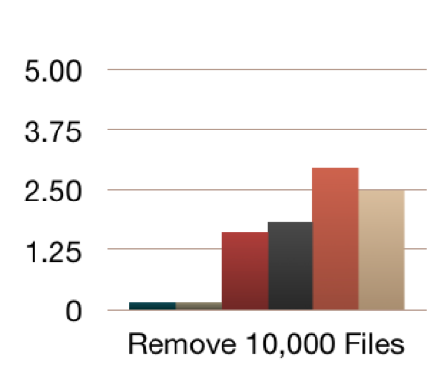
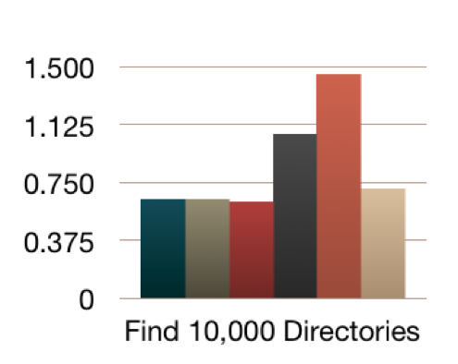
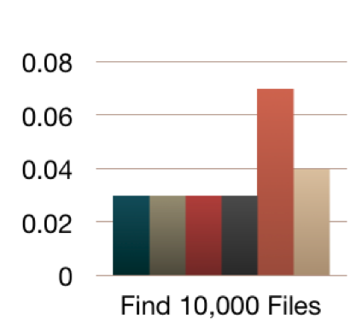
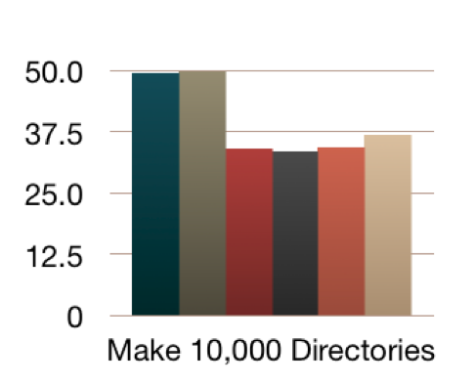
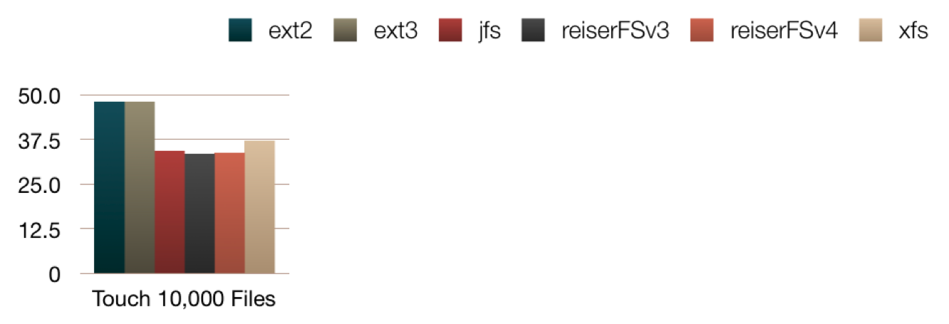
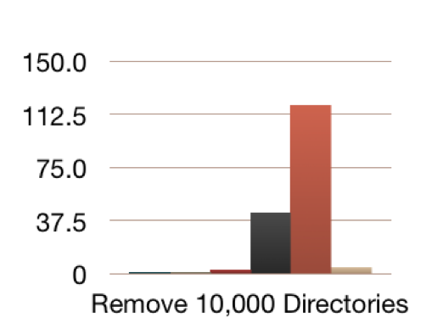
Gazette: Time in Seconds

Slide 92
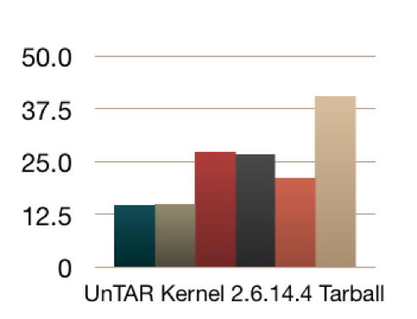
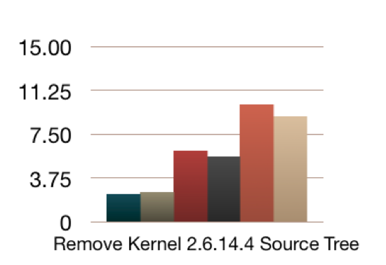
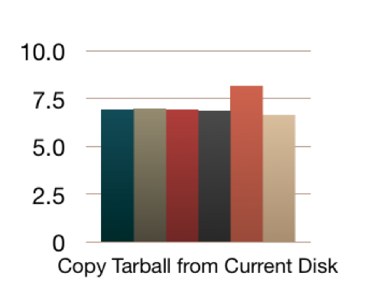
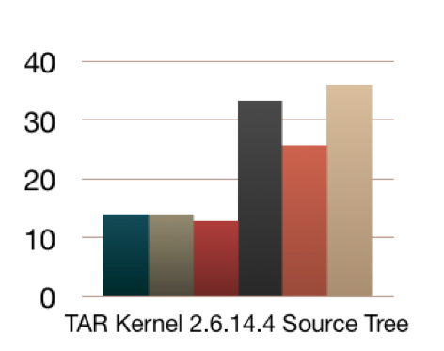
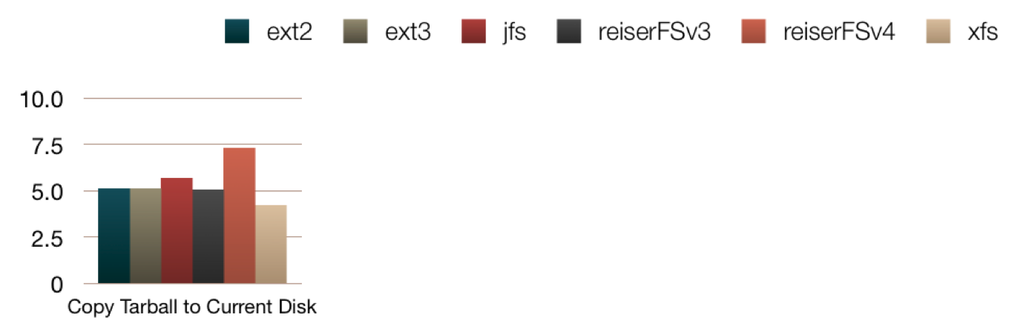
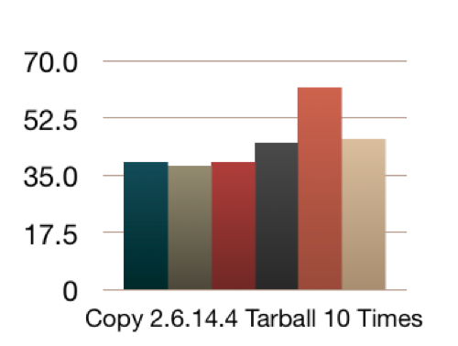
Gazette: Time in Seconds

Slide 93
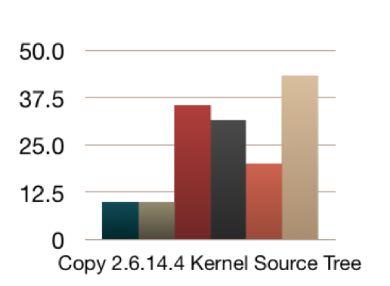
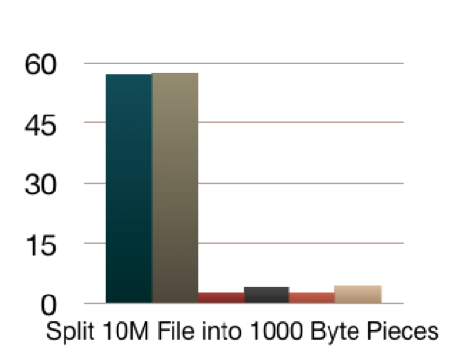
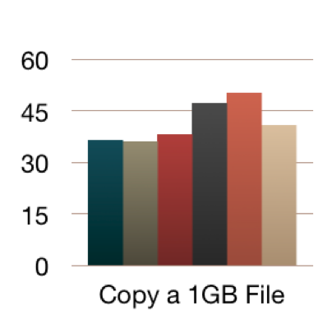
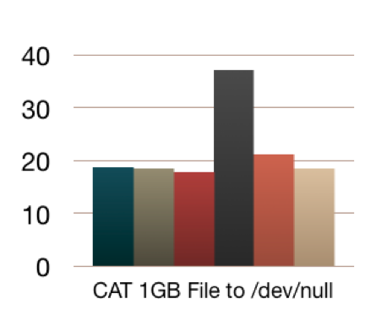
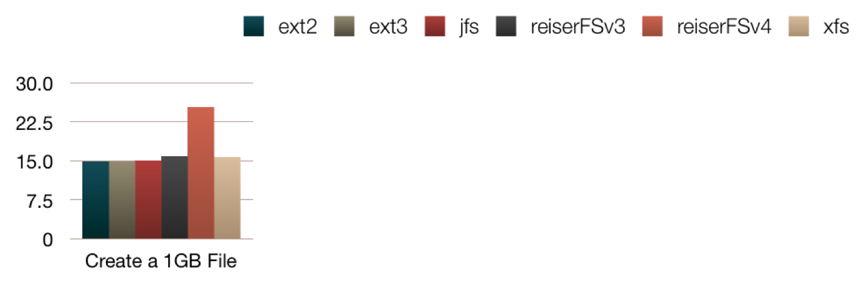
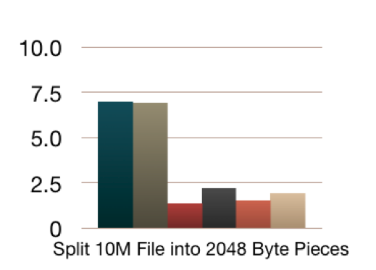
Gazette: Time in Seconds

Slide 94
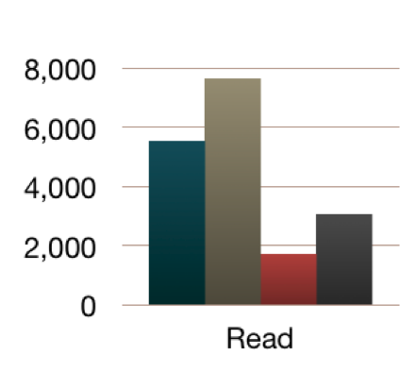
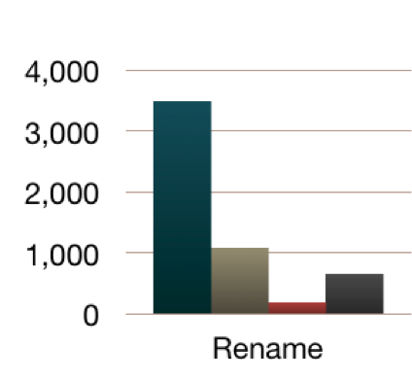
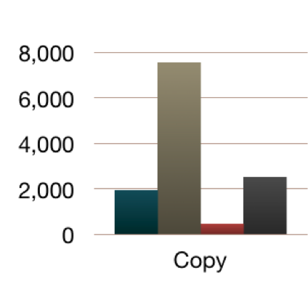
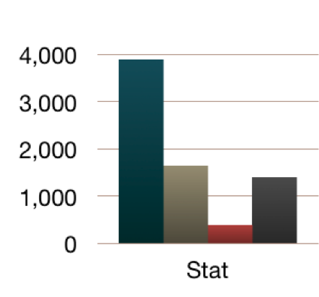
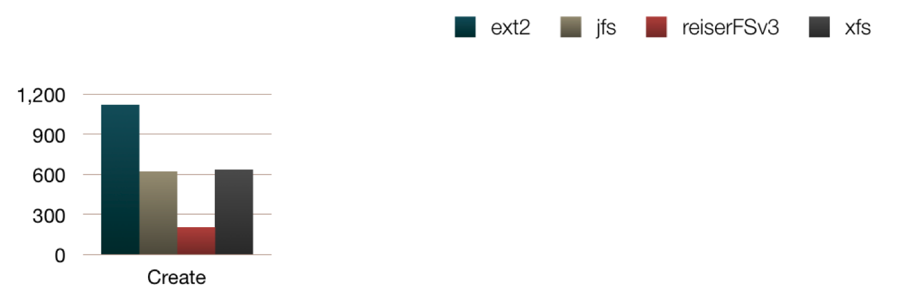
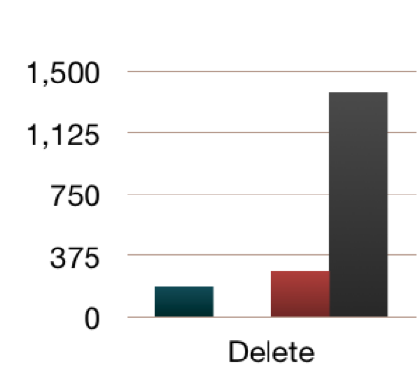
Mango (100 byte files): Time in Seconds

Slide 95
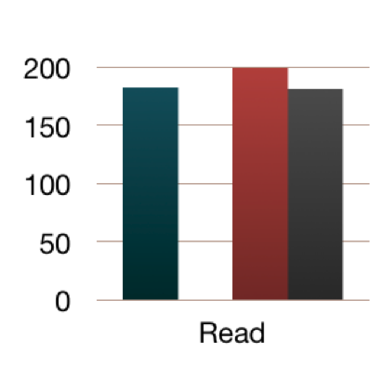
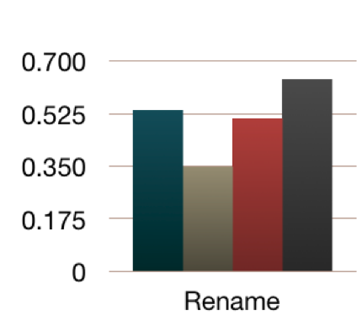
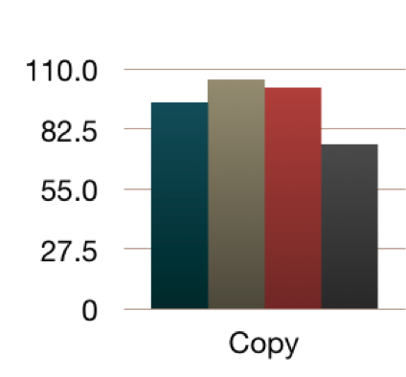
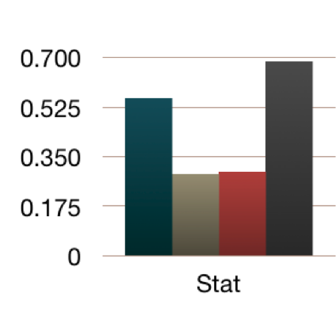
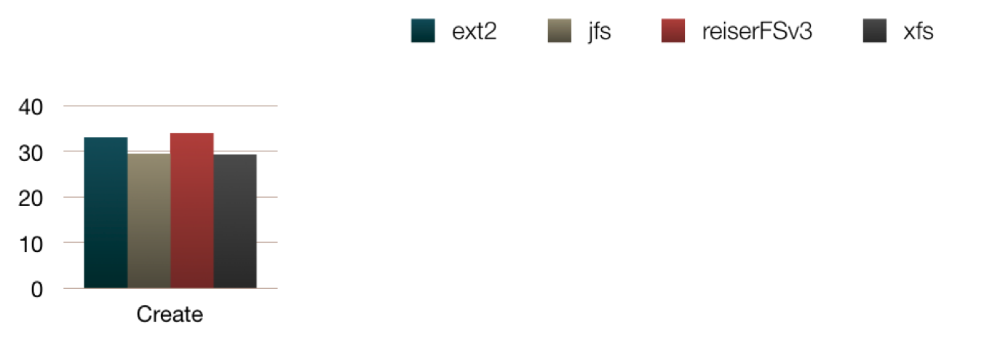
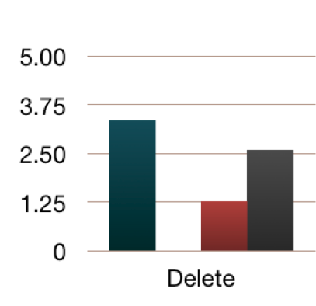
Mango (1M files): Time in Seconds

Slide 96
HFS+
Developed by Apple to solve problems with HFS
Fully journaled data with write through
B+Trees for:
  Catalog File, Extents Overflow File, and Attributes File
Data divided into sectors

Slide 97
NTFS
Created by Microsoft to replace FAT32
Allows for sparse files
B+Trees for indexing
Journaled Meta data
Everything about a file is meta-data and can be easily expanded and customized
Future of NTFS is WinFS
  Relational database representing a filesystem
  Developed on top of NTFS

Slide 98
ZFS
Created by SUN
Pooled storage model
  Can combine multiple drives as one
Borrows ideas from RAID-5 and adds journaling to prevent parity corruptions
Build in snapshot and clone features
Build in backup and restore
Build in compression

